Slide 1
SPRING FRAMEWORK
AMOL R PATIL - 9822291613PUNE

Slide 2

What is SPRING ?
Spring is an open source Java Application Framework that provides comprehensive infrastructure support for developing Java enterprise Applications
Spring handles the infrastructure so you can focus on your application.
Spring enables you to build applications from “plain old Java objects” (POJOs) and to apply enterprise services non-invasively to POJOs

Slide 3
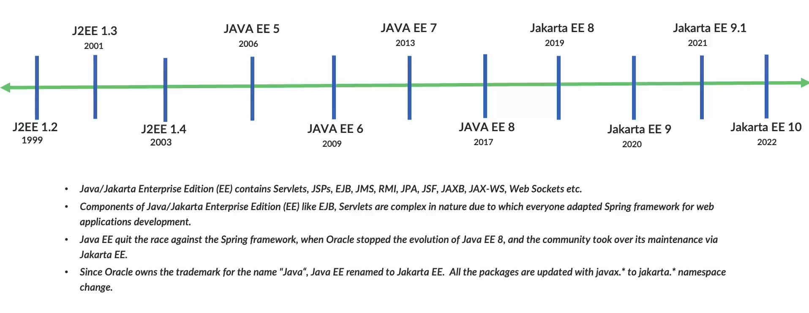
J2EE and Spring
Spring is an enterprise Java framework. It was designed to simplify Java EE development and make developers more productive. Spring makes use of Inversion of Control and Dependency Injection to promote good software coding practices and speed up development time.

Slide 4
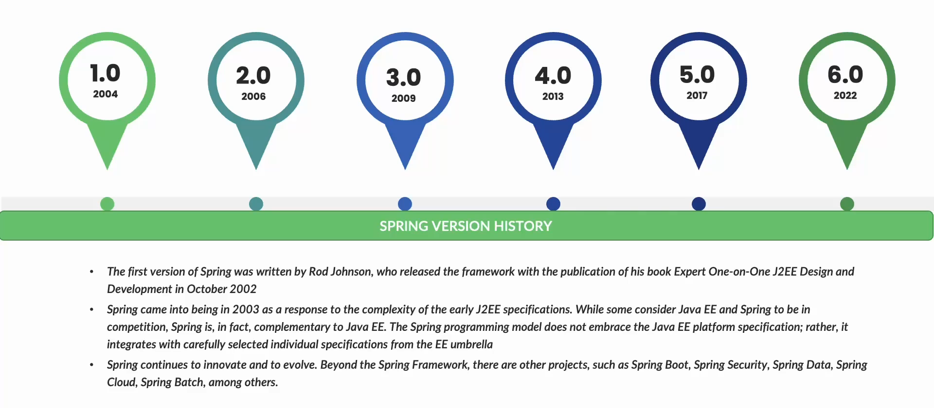

Slide 5
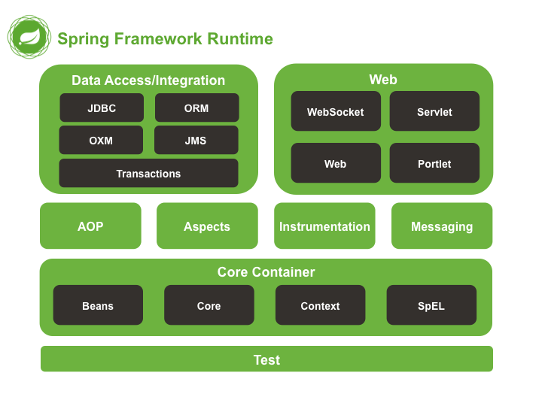

Slide 6
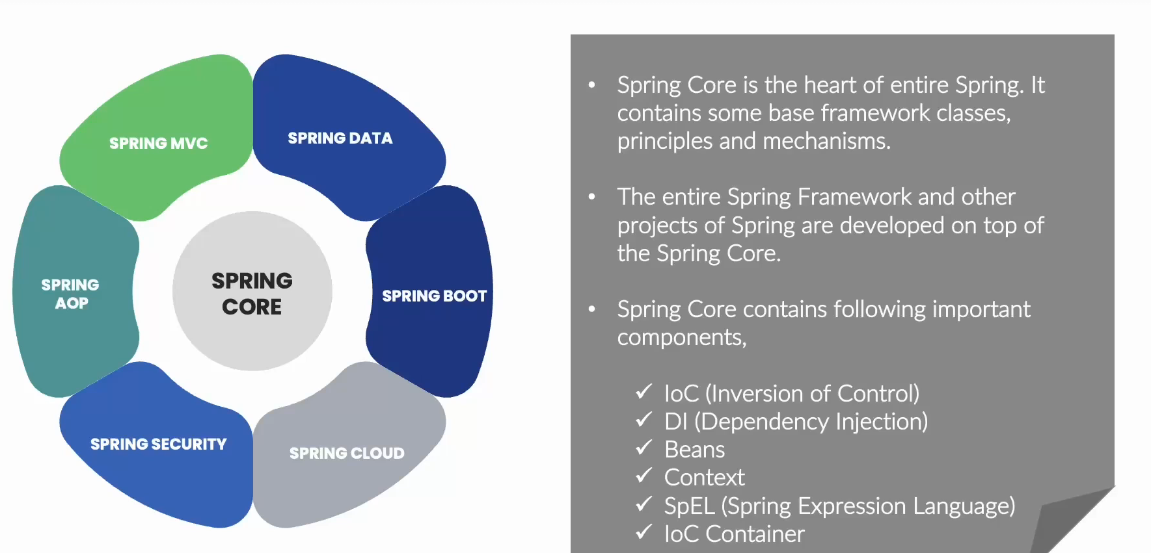

Slide 7
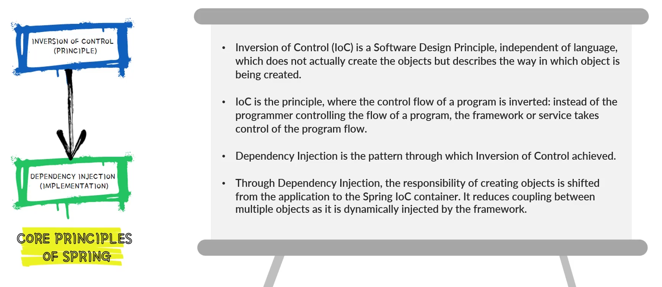

Slide 8
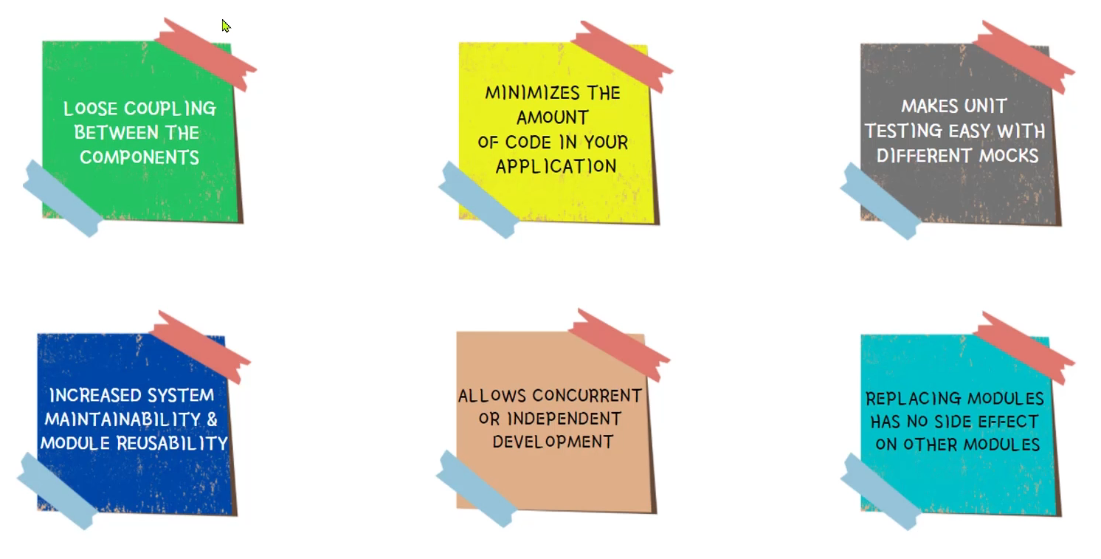
Advantages of IOC and DI

Slide 9
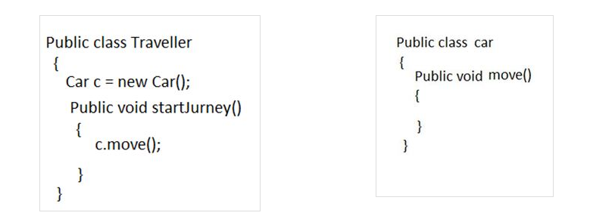
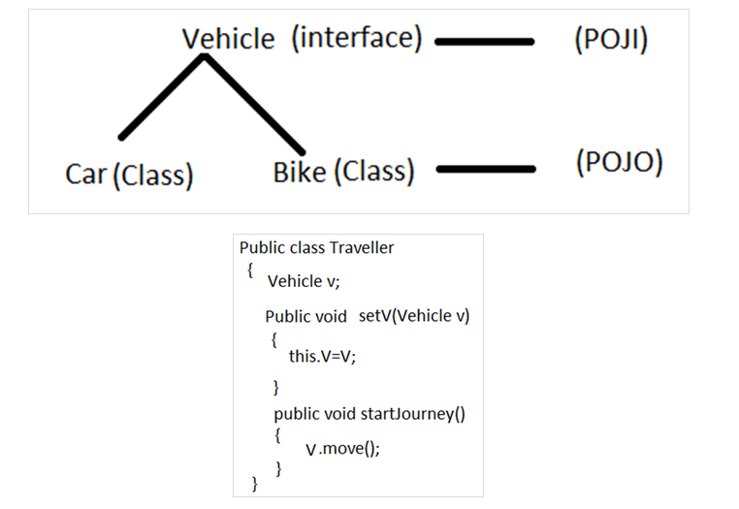
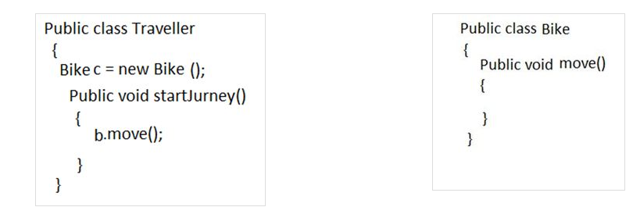
Coupling
A situation where an object can be used by another object is termed as coupling.

Slide 10
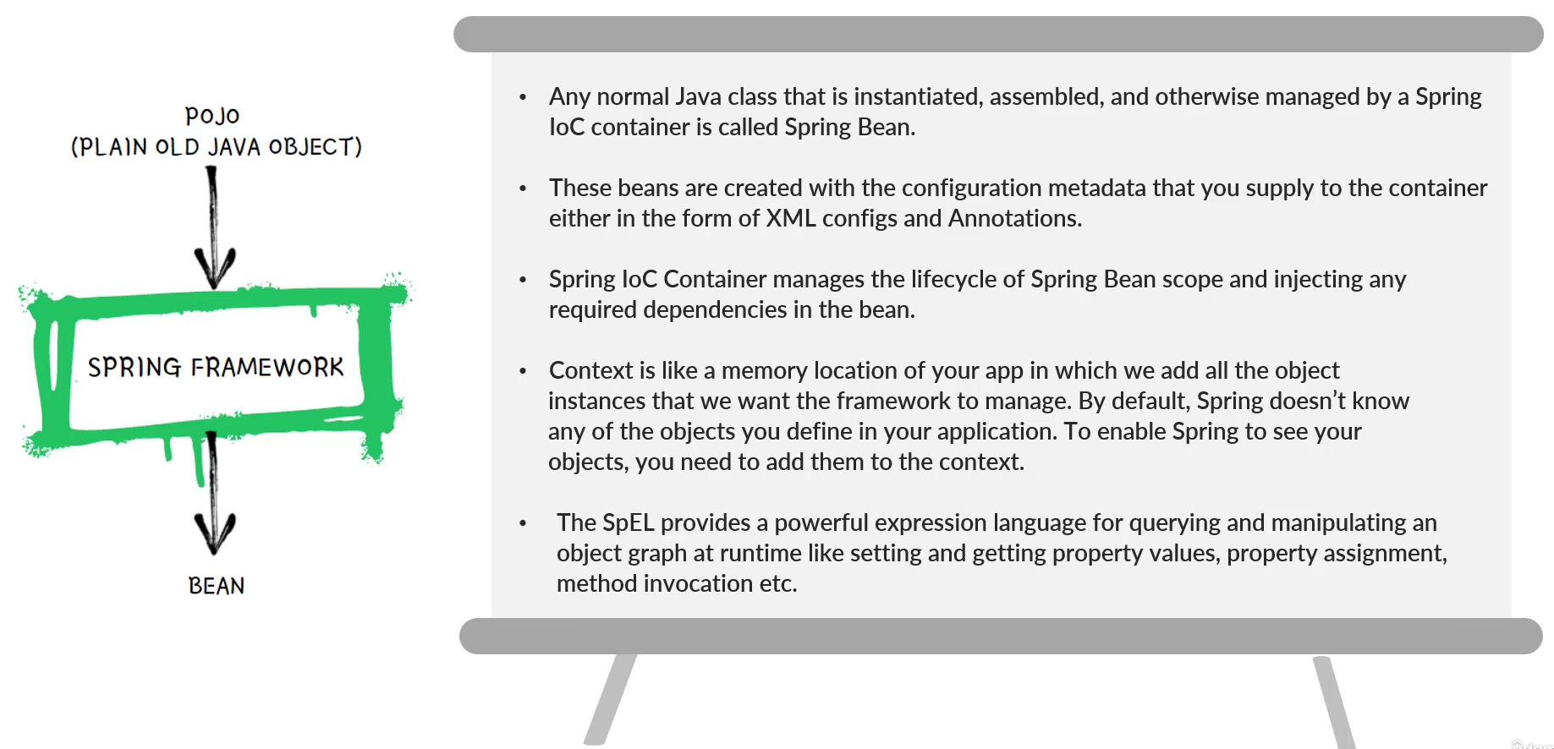

Slide 11
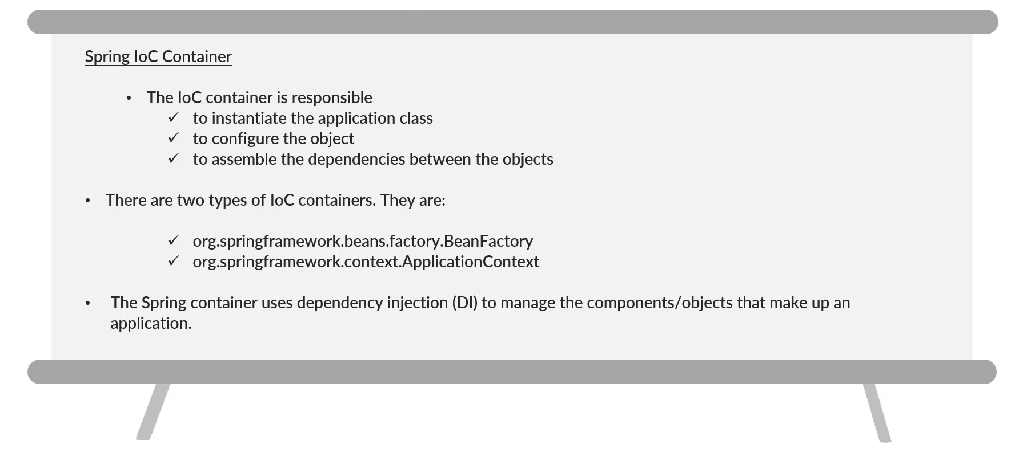

Slide 12
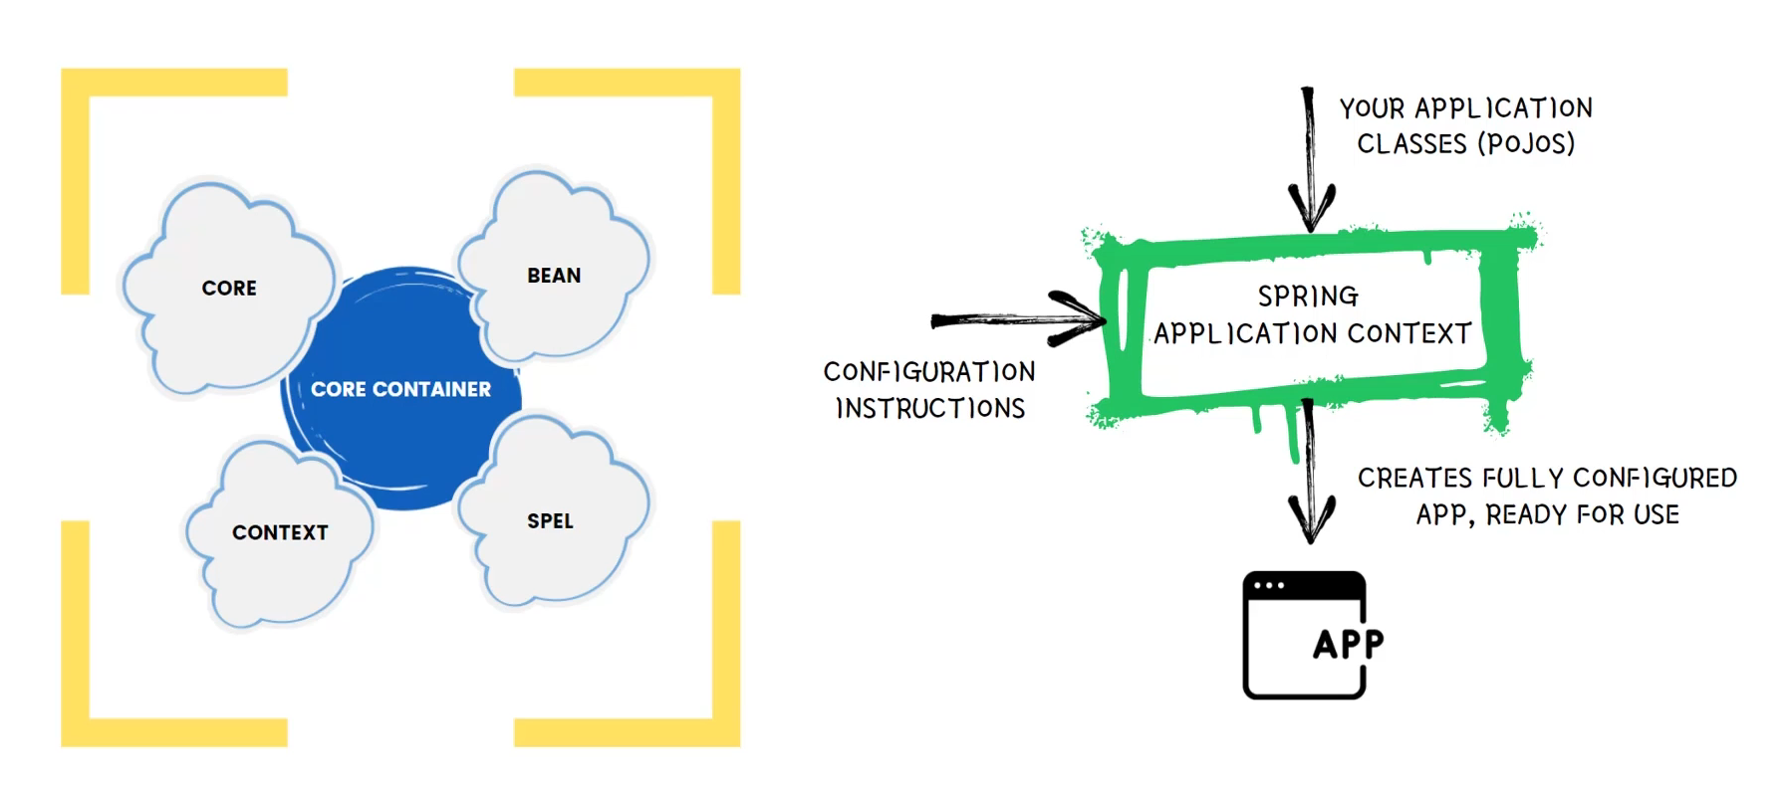
Spring IOC Container

Slide 13
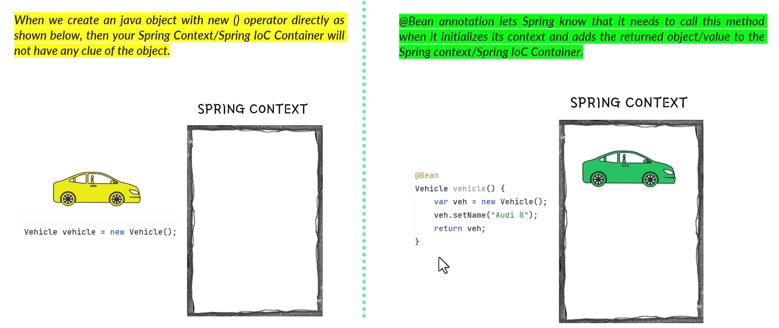
Adding Bean to Application Context

Slide 14
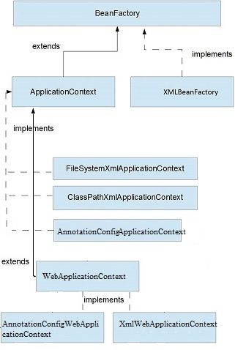
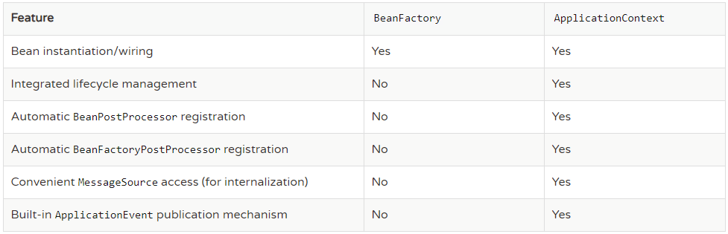
Bean Factory and Application Context

Slide 15
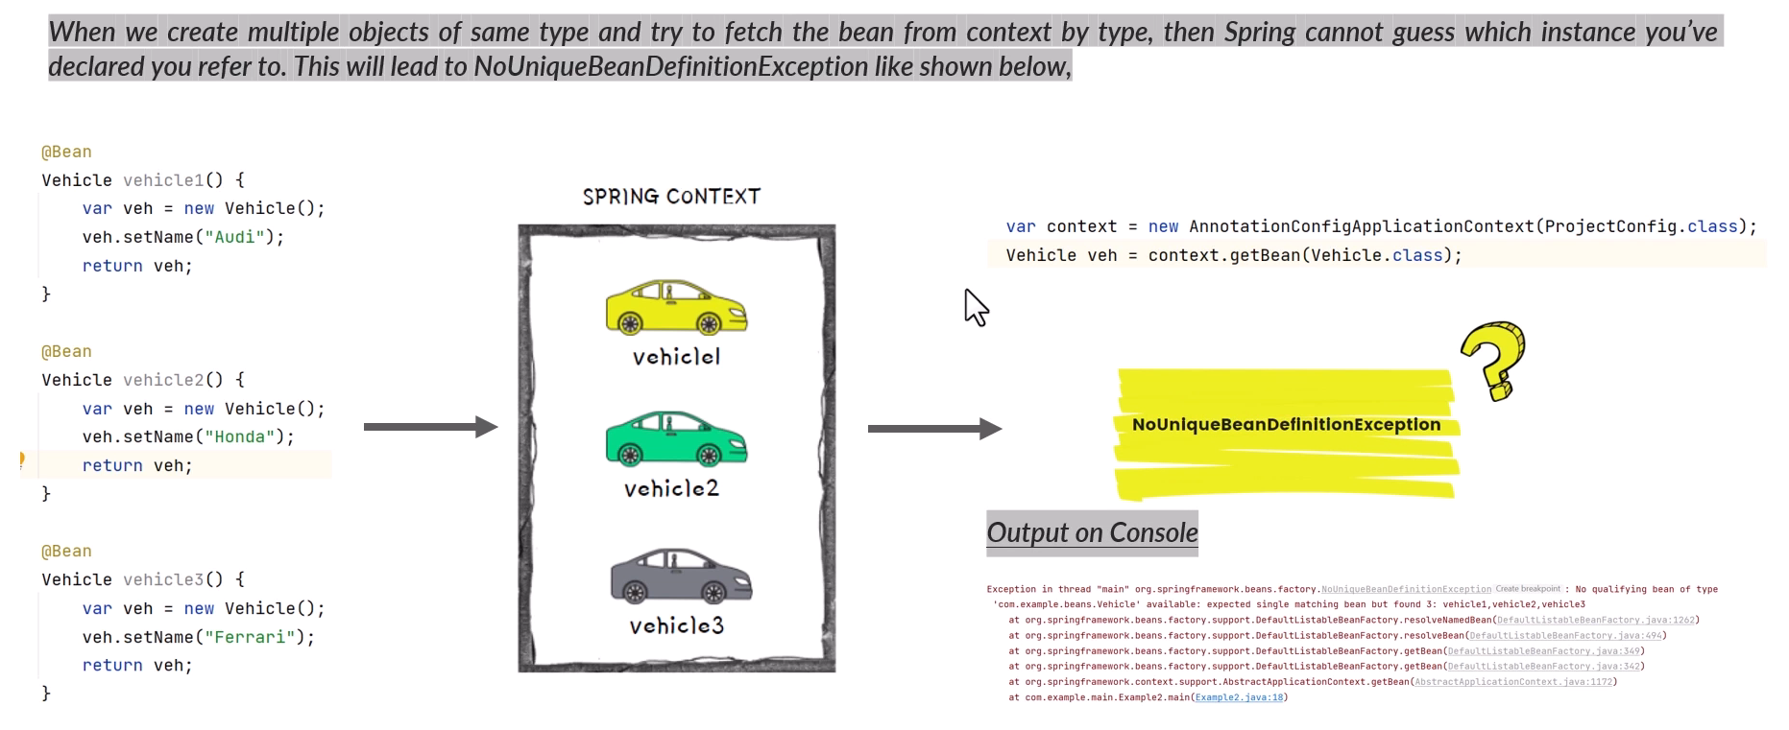
NoUniqueBeanException

Slide 16
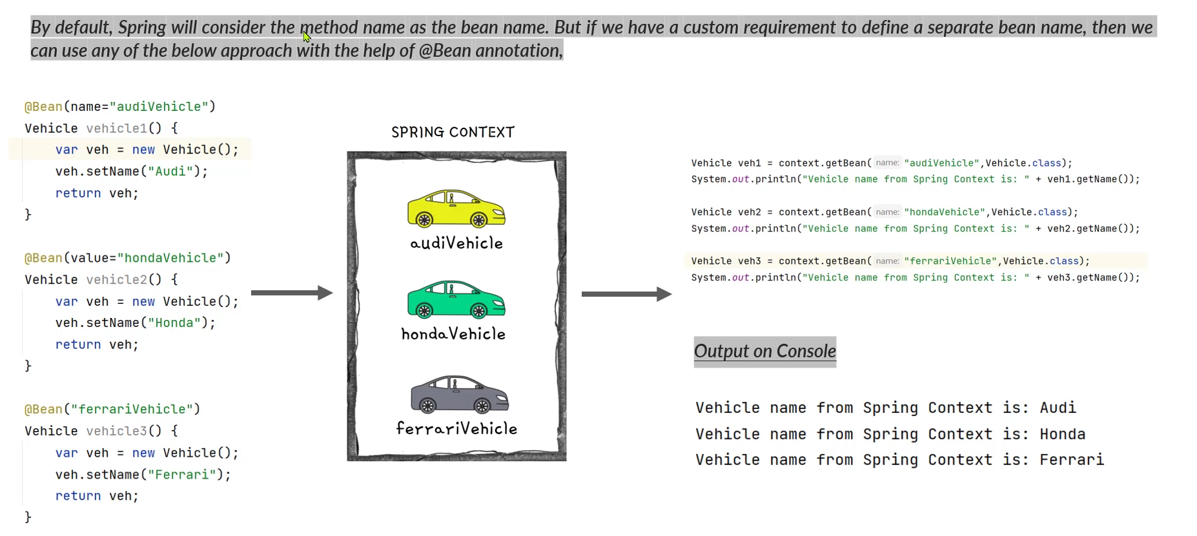
Providing Custom name to Beans

Slide 17
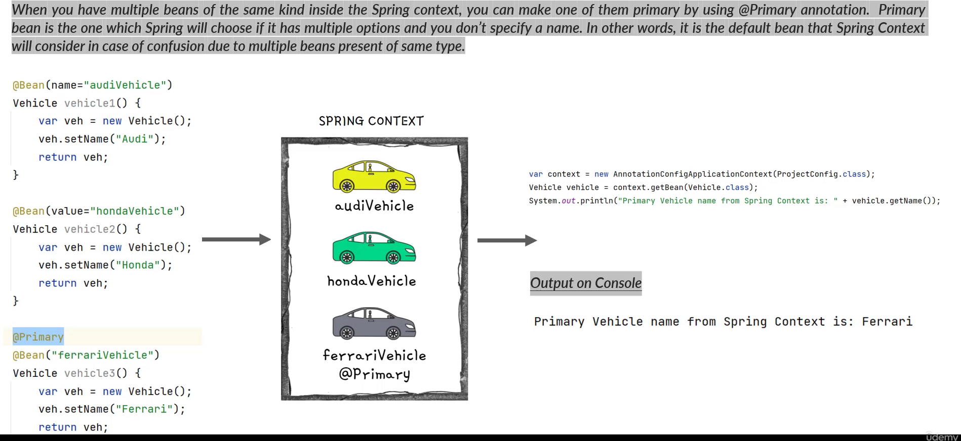
Primary Bean

Slide 18
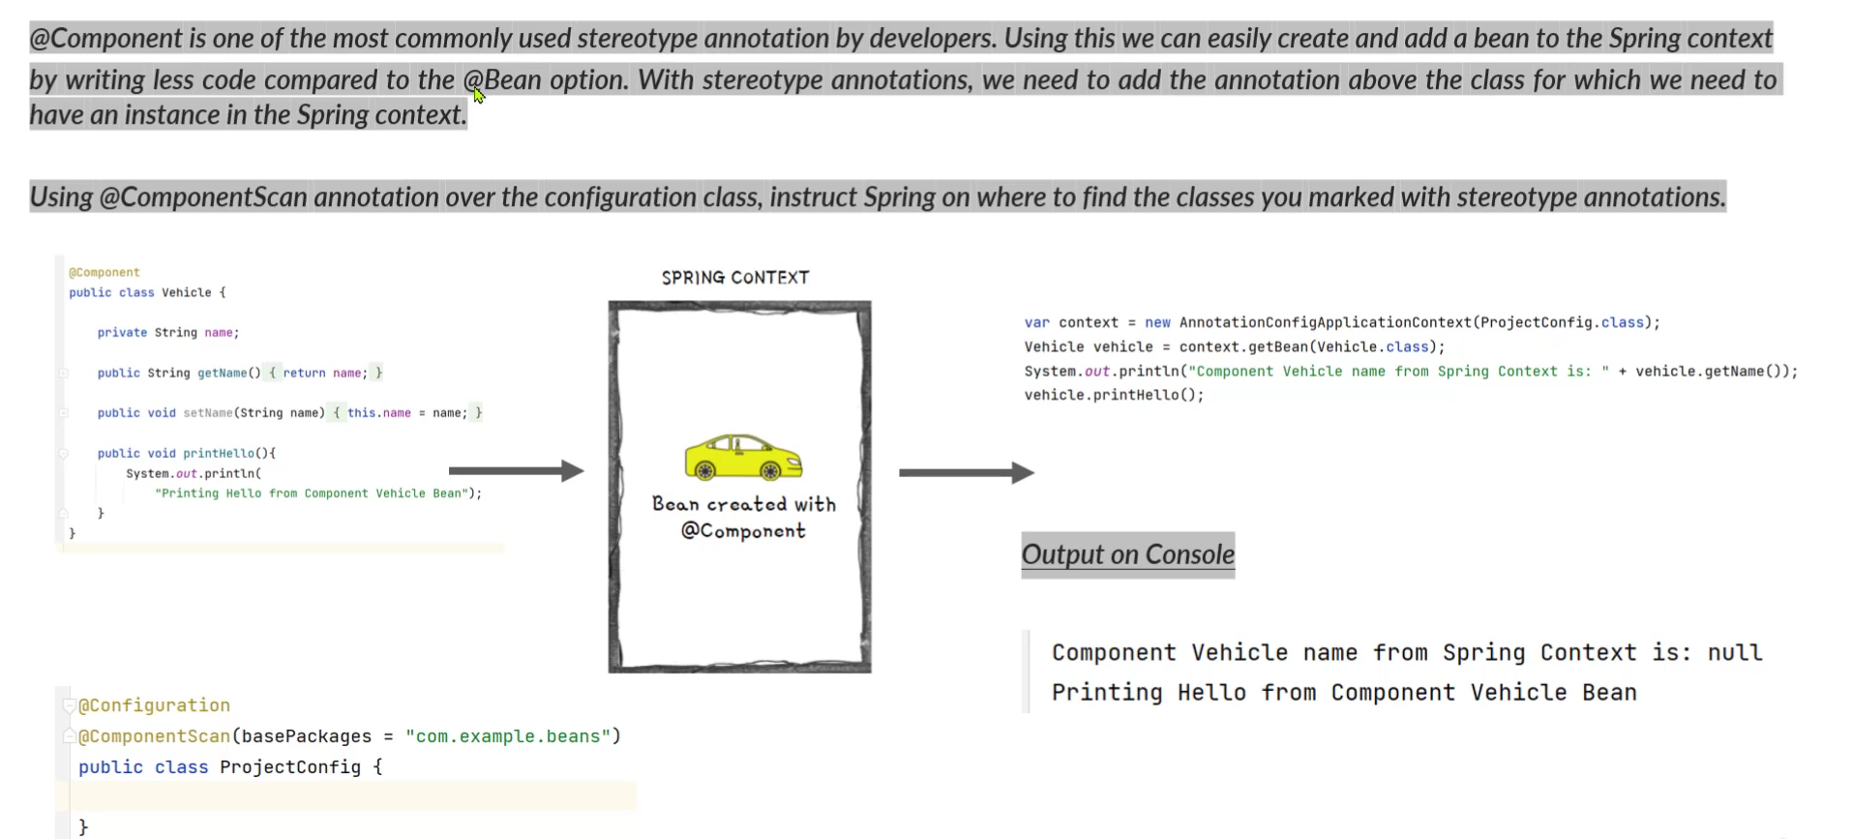
@Component Annotation

Slide 19
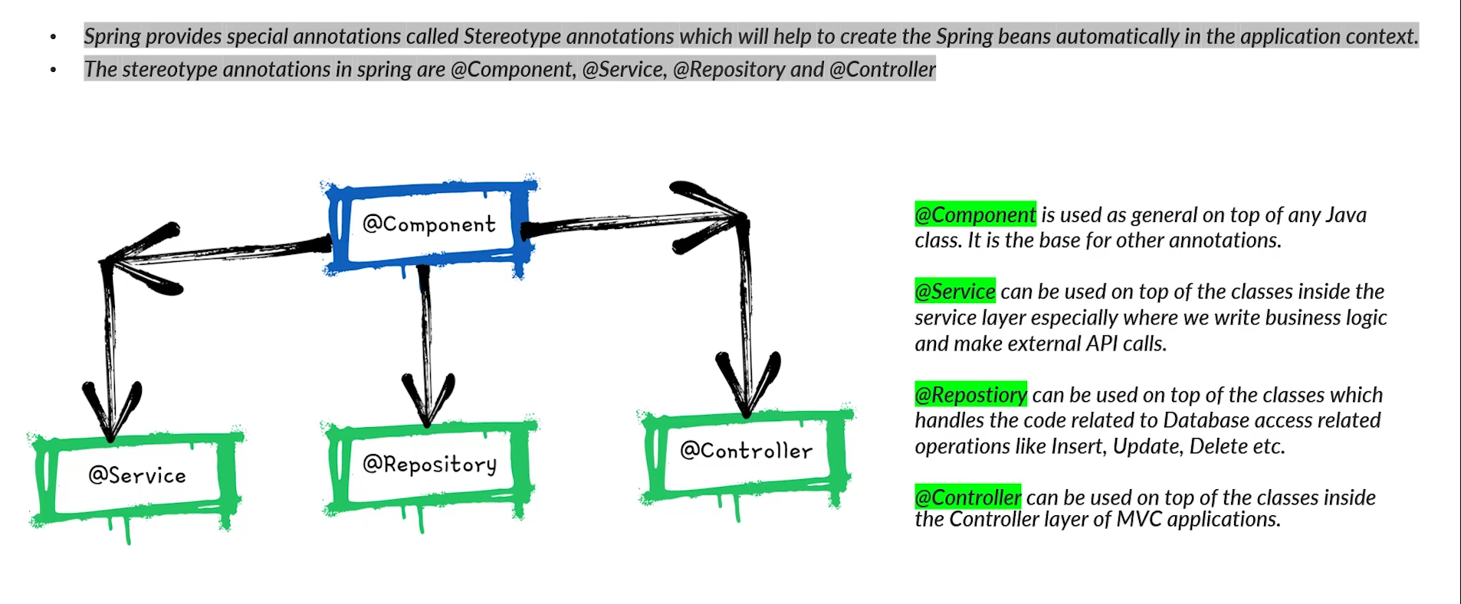
Spring StereoType Annotations

Slide 20
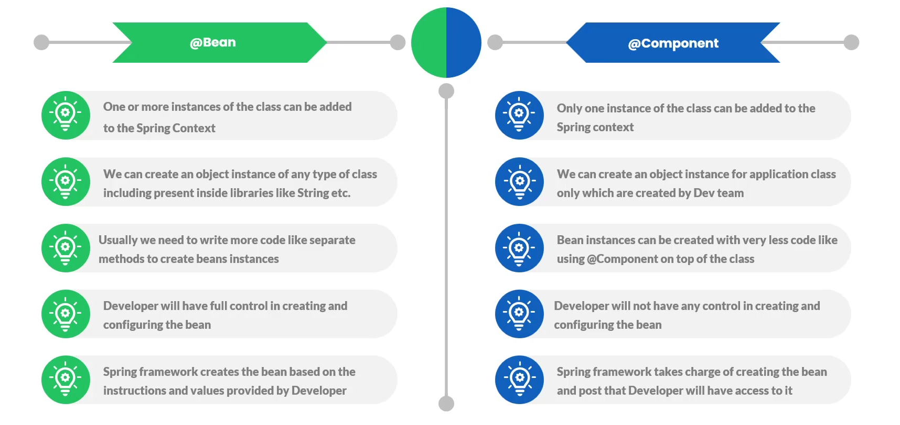
Bean Vs. Component Annotations

Slide 21
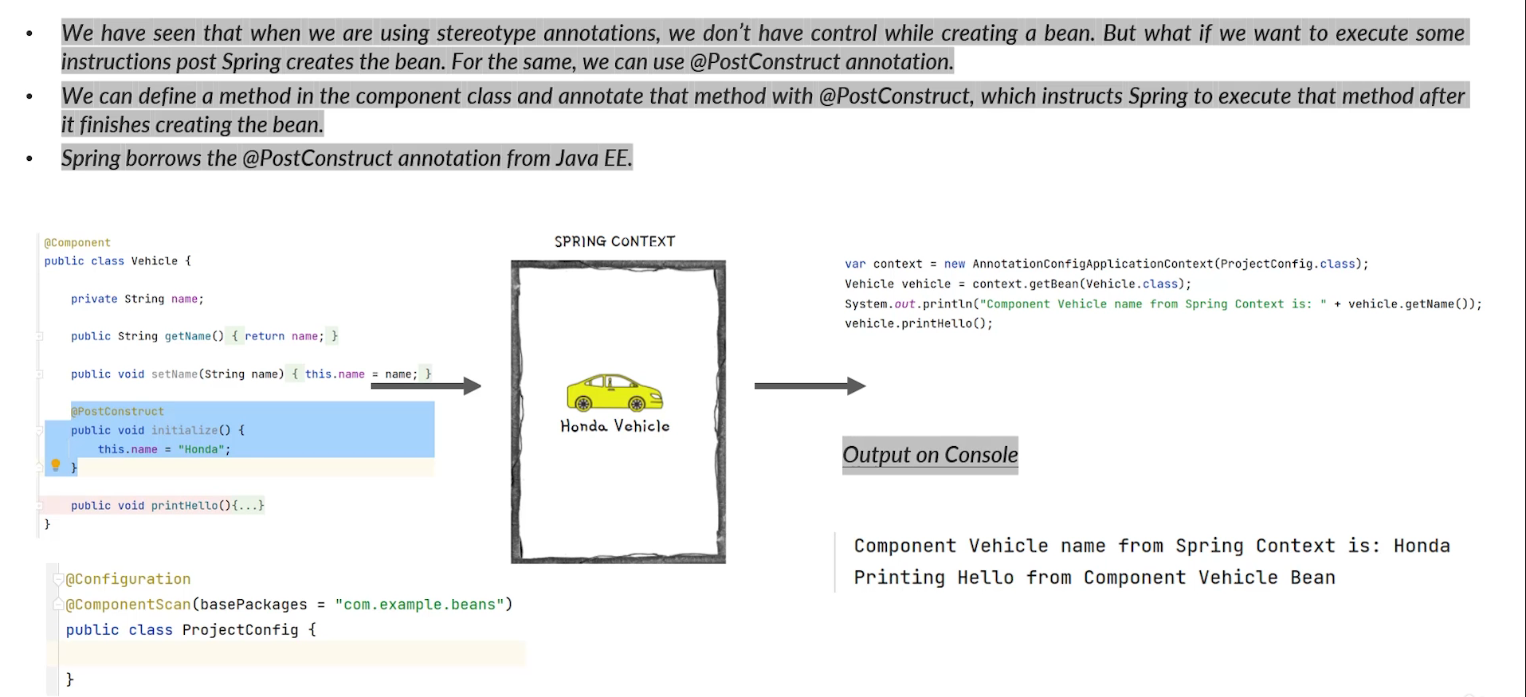
@PostConstruct Annotation

Slide 22
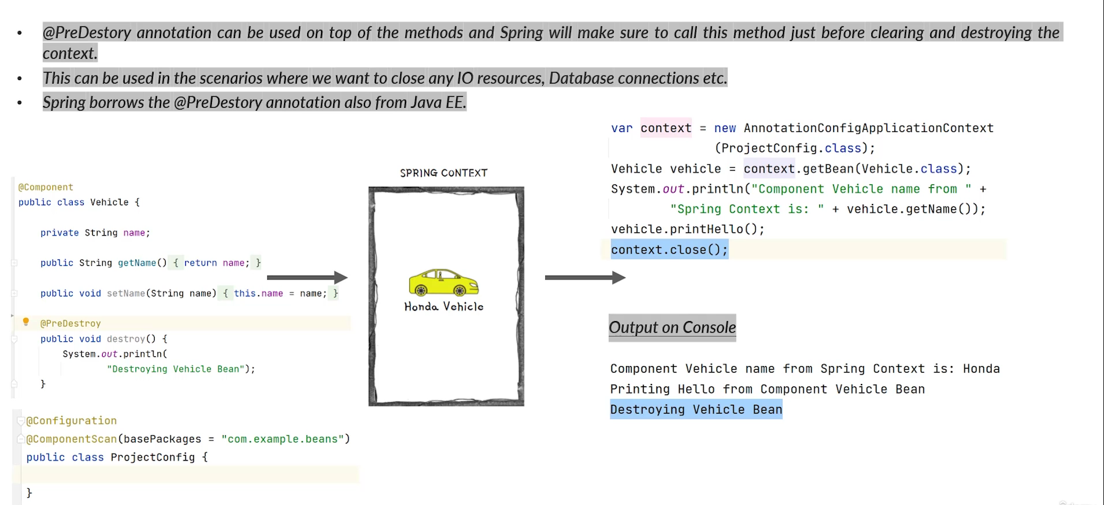
@PreDestroy Annotation

Slide 23
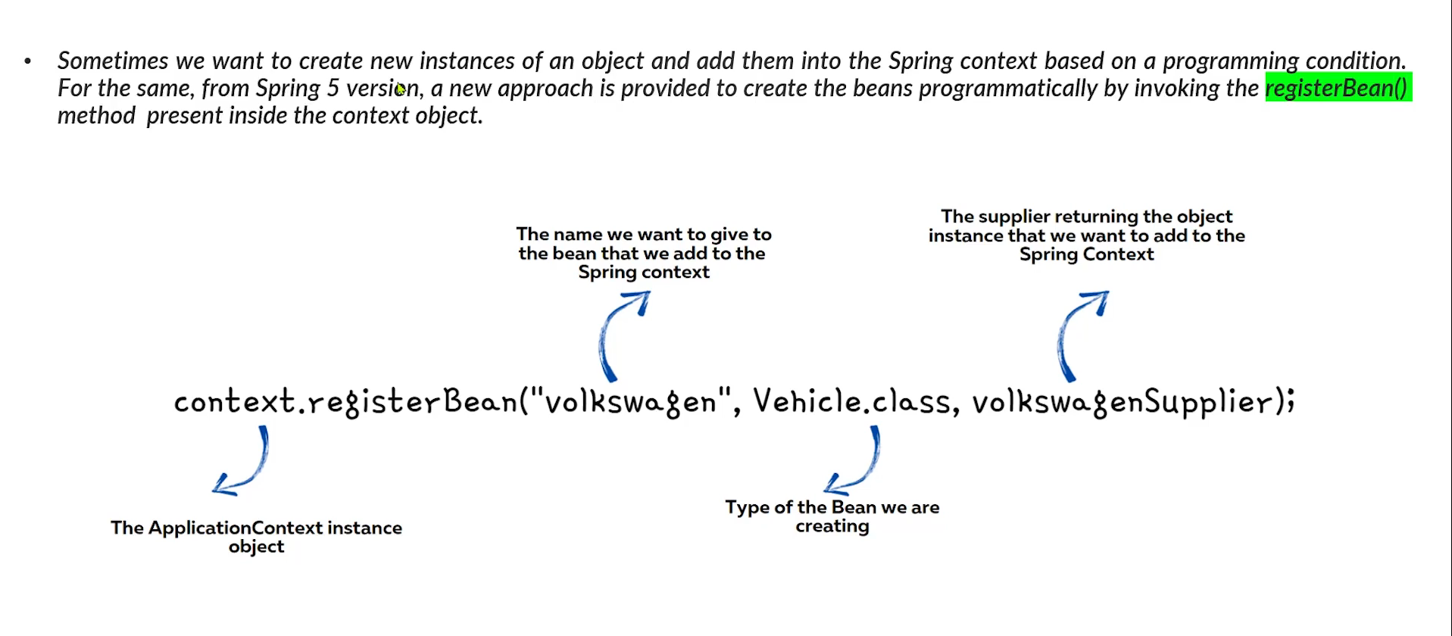
Adding New Bean Programmatically

Slide 24
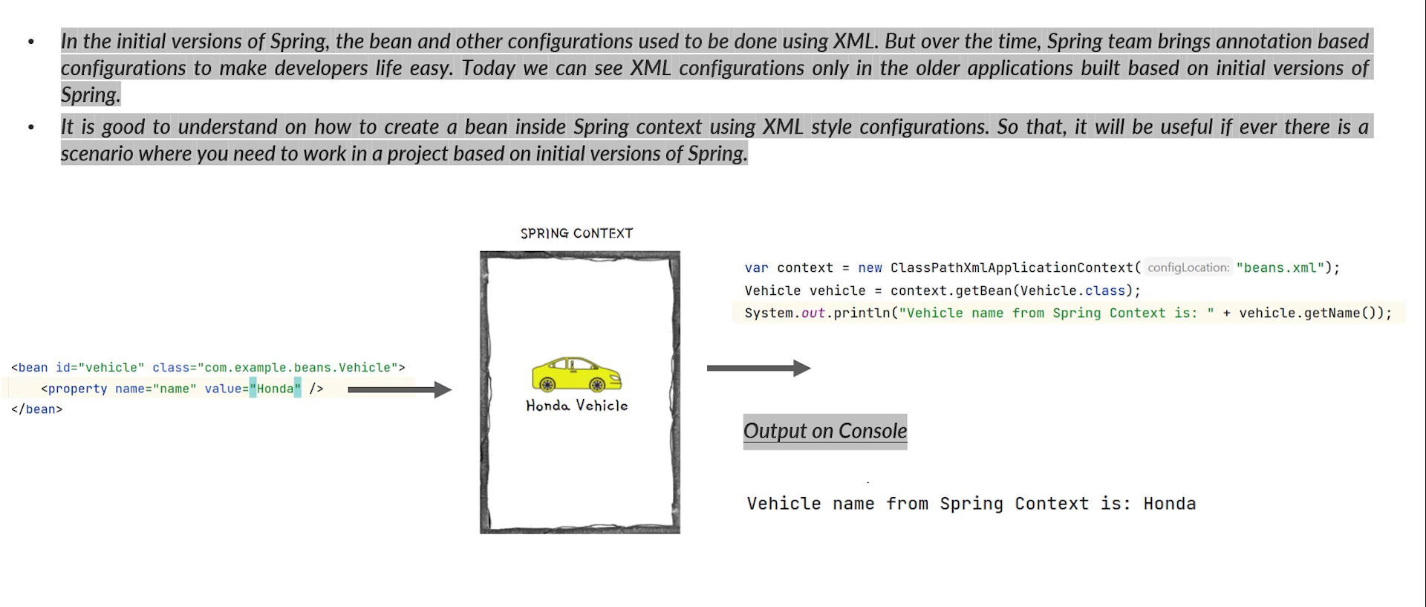
Adding New Bean Using XML

Slide 25
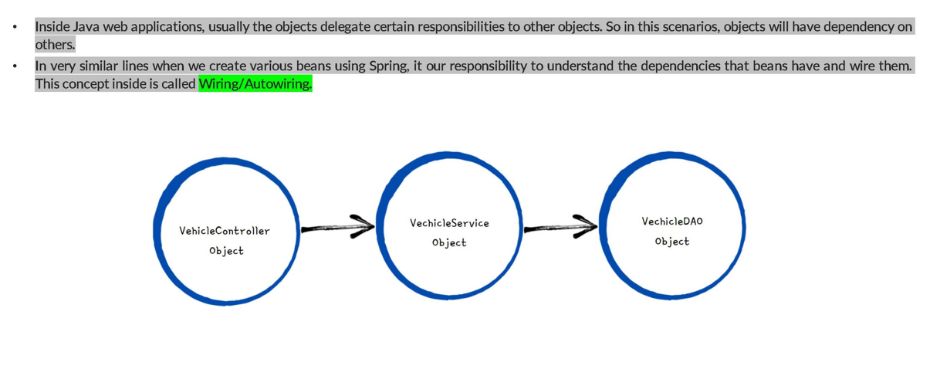
Beans Wiring Inside Spring

Slide 26
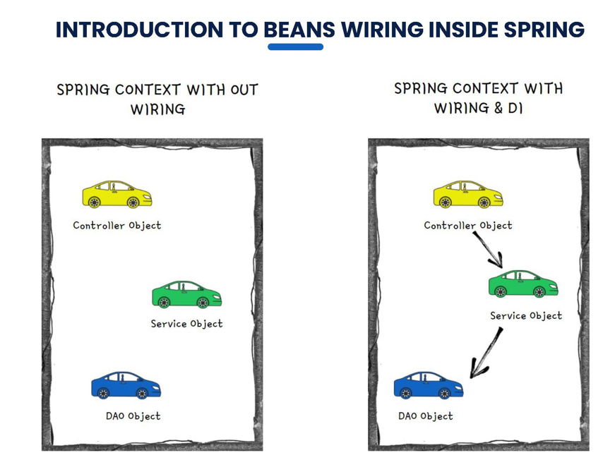

Slide 27

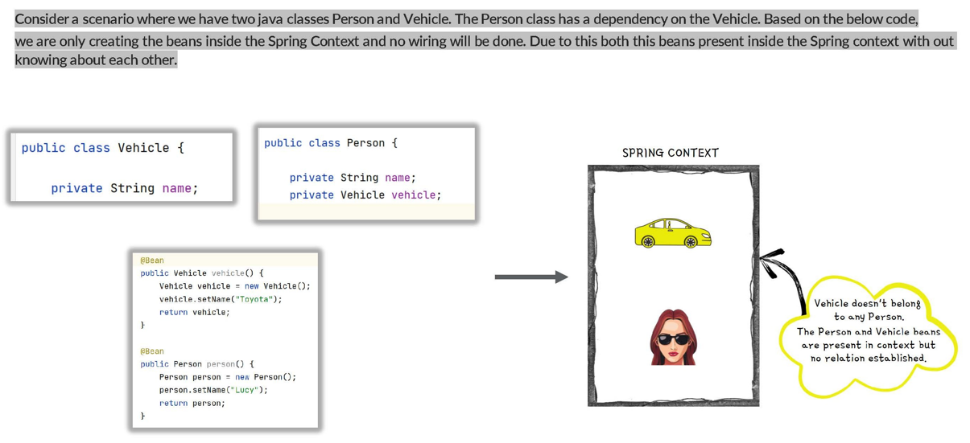

Slide 28

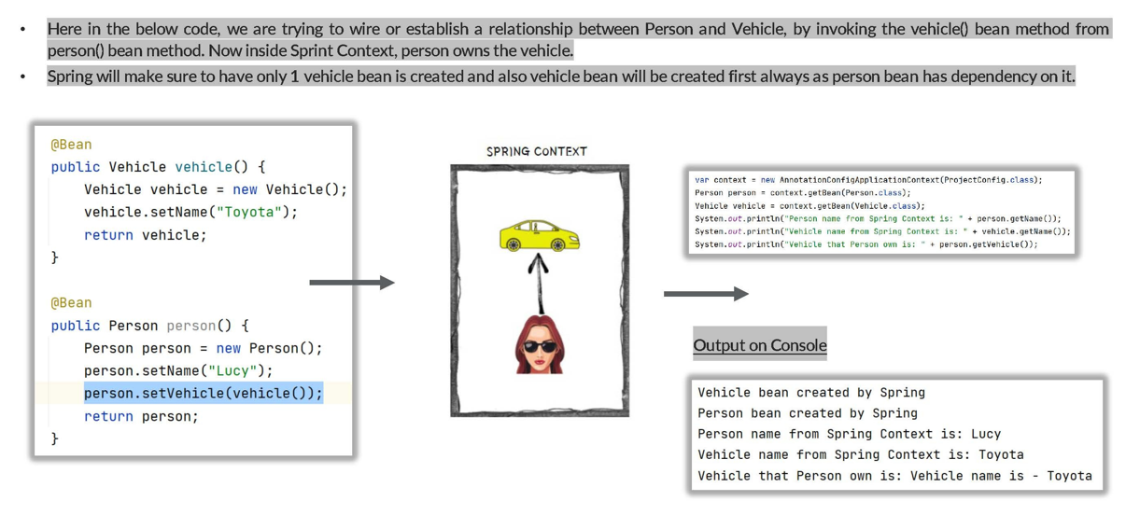
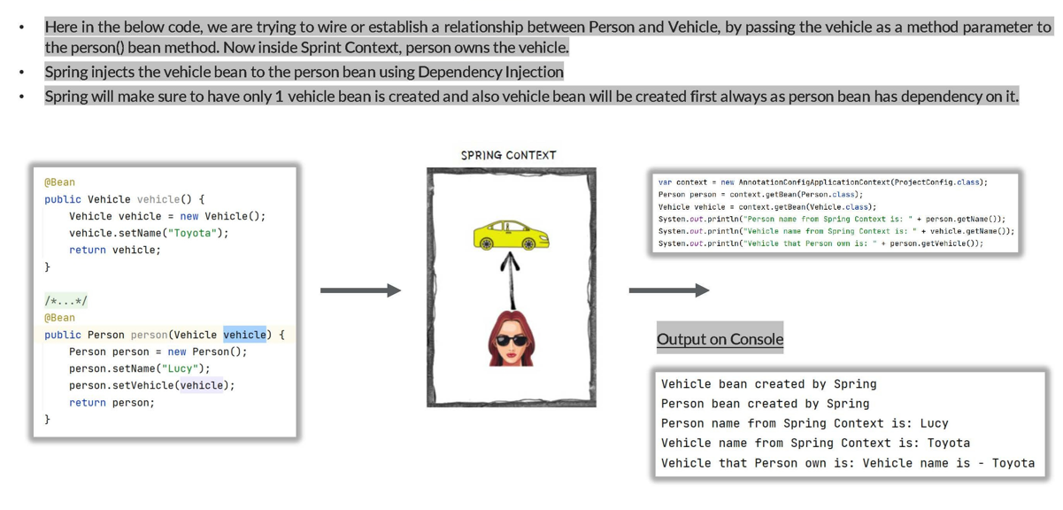

Slide 30
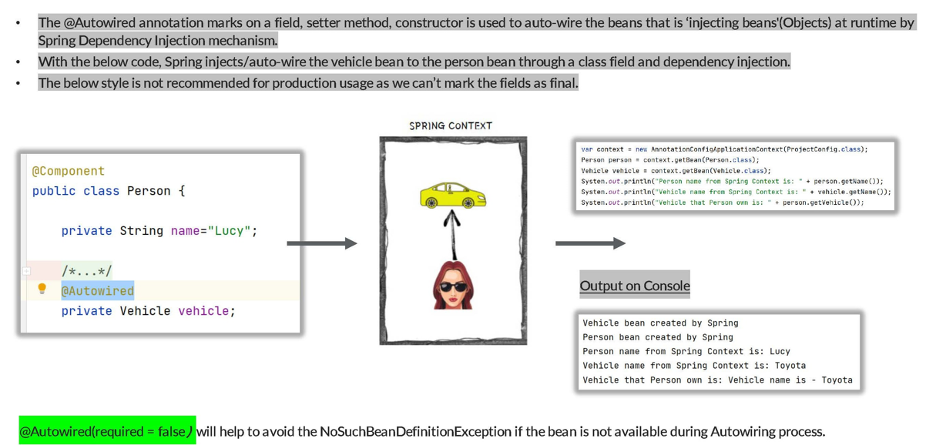

Slide 31
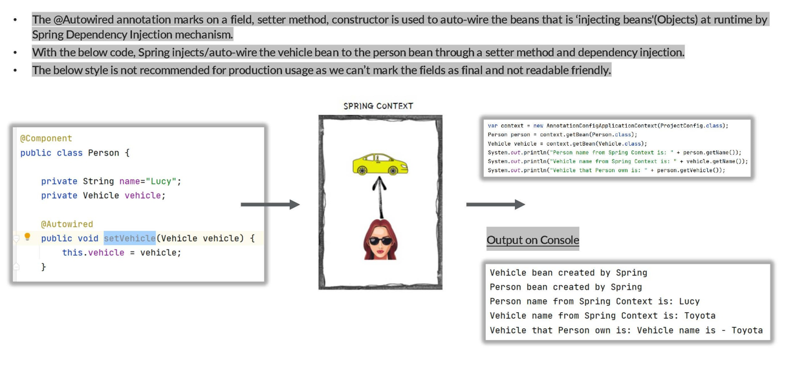

Slide 32
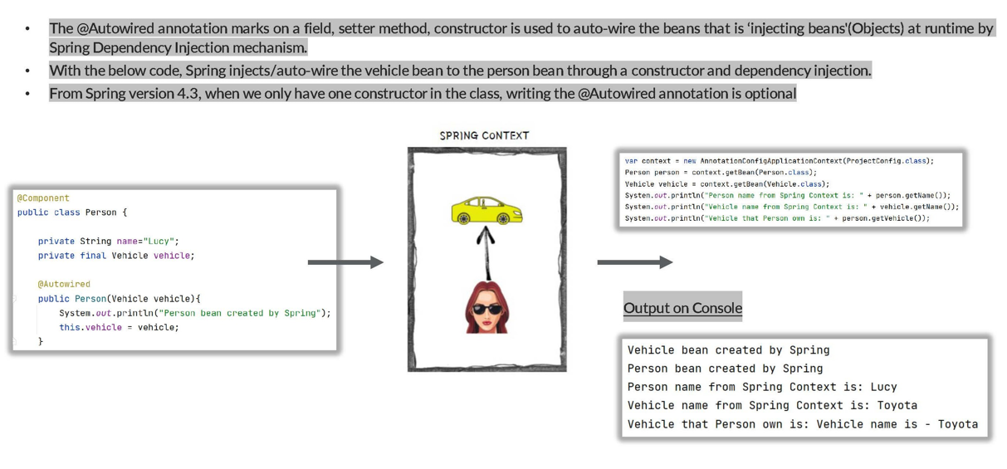

Slide 33
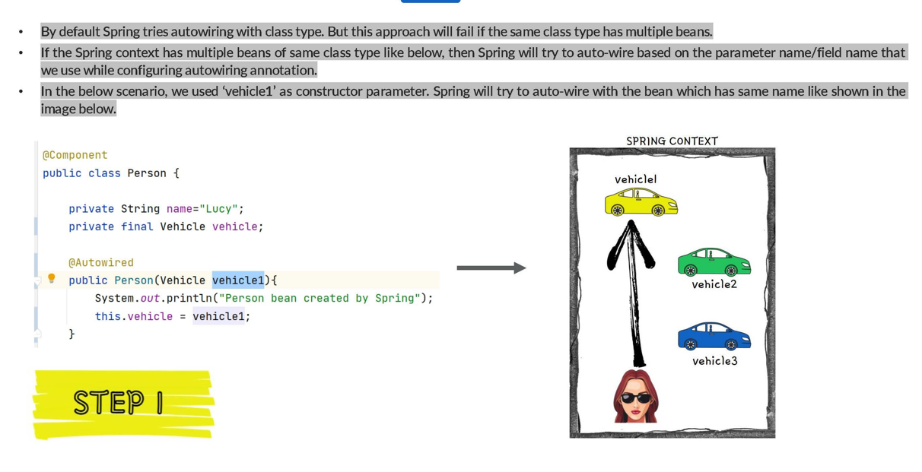

Slide 34
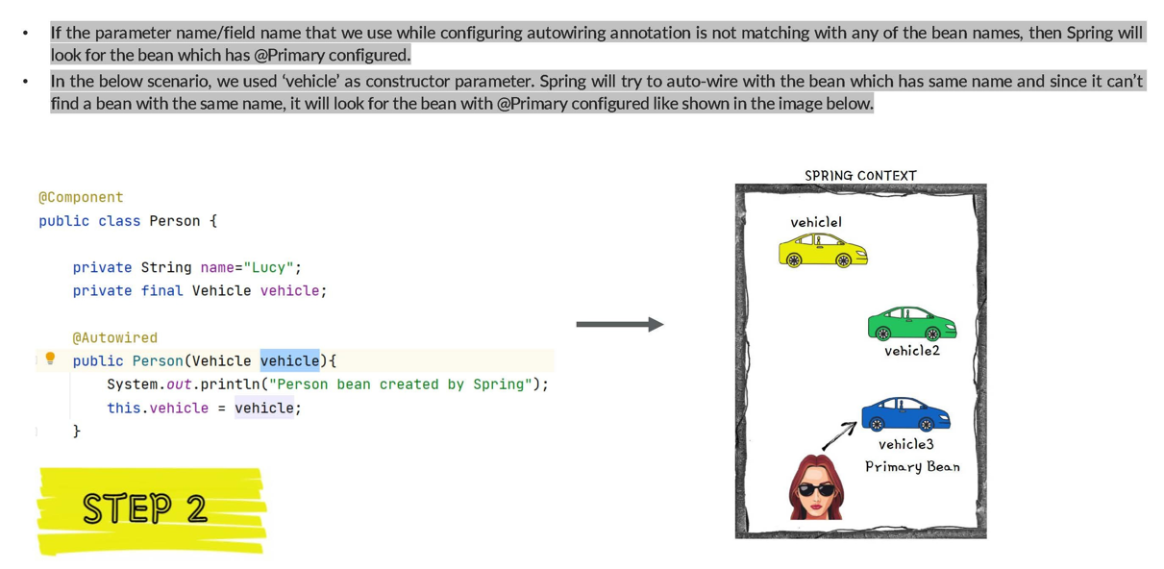

Slide 35
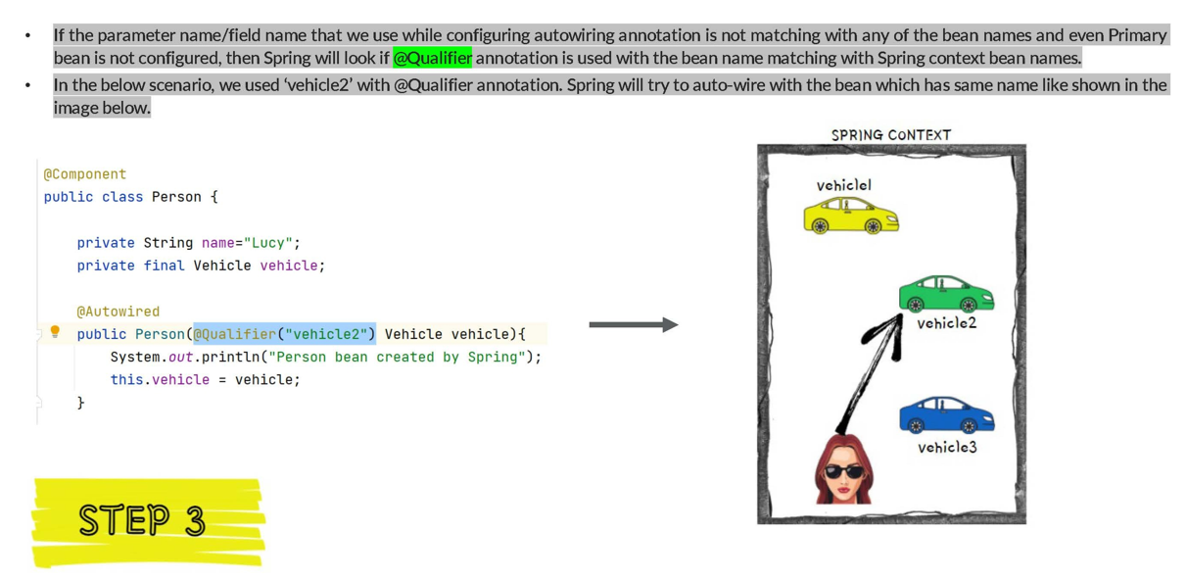

Slide 36

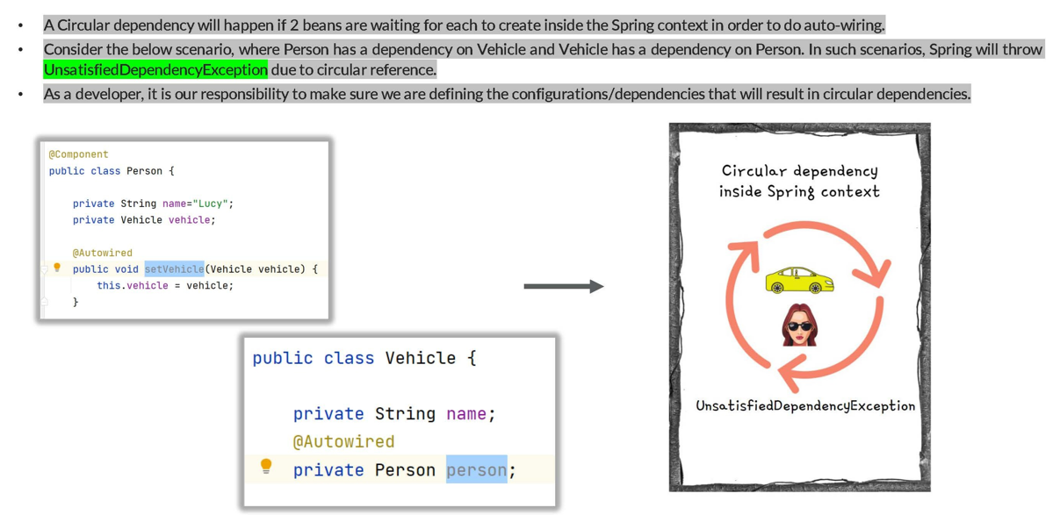

Slide 37
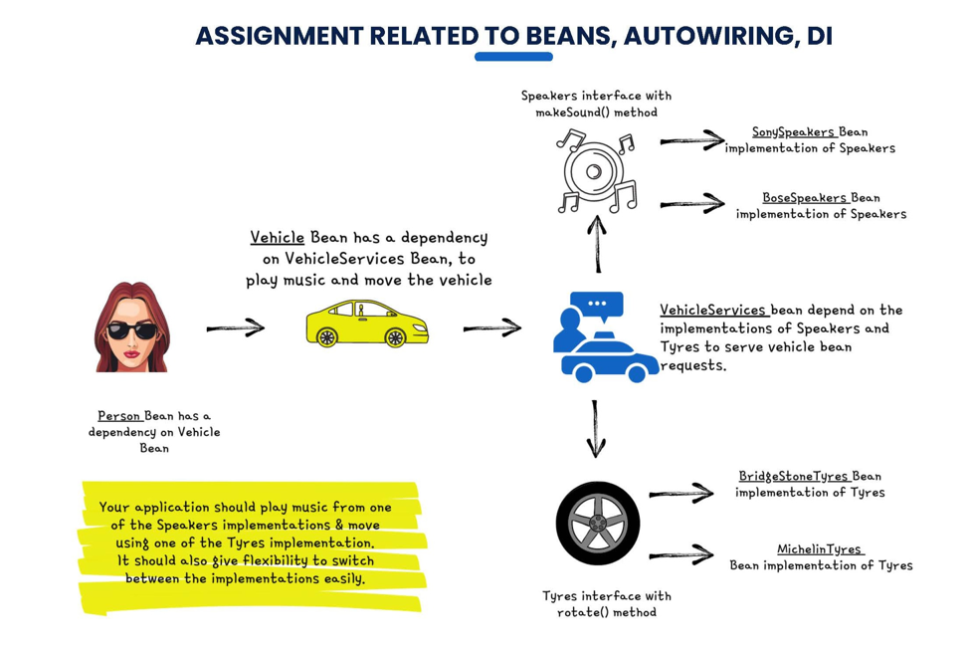

Slide 38
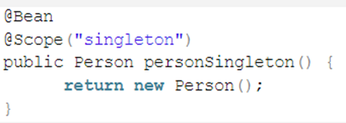
Spring Bean Scope
Scope | Description
singleton | It is the default scope of a bean. It represents a single bean scope for each Spring IoC container.
prototype | It is used to set the scope of a single bean definition to any number of object instances.
request | This bean scope is set for a single HTTP request.
session | This scope is set for a single bean definition to an HTTP session.
application | It sets bean scope to a ServletContext.

Slide 39
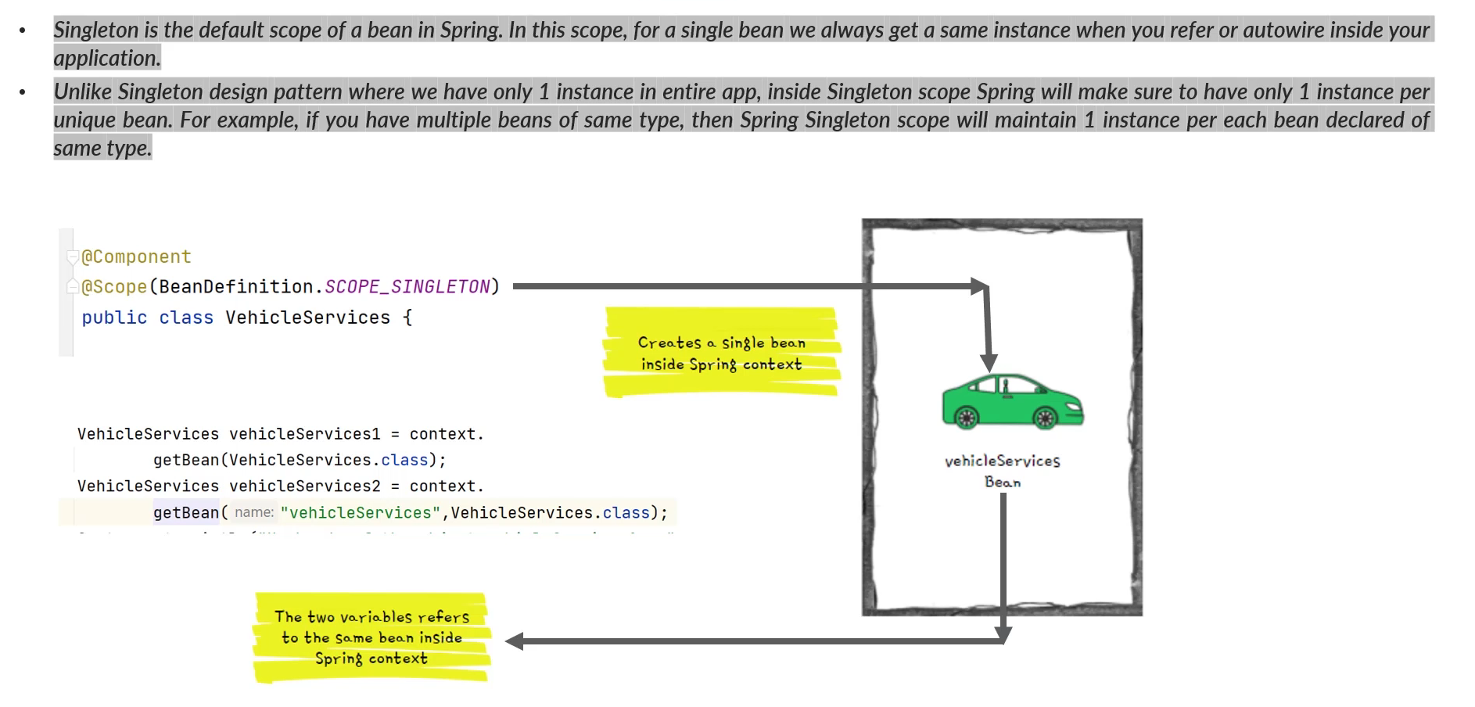
Singleton Bean Scope

Slide 40
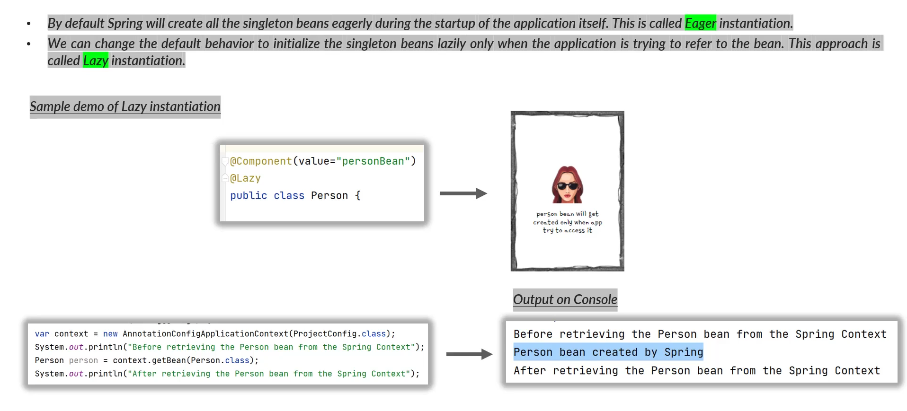
Eager and Lazy Instantiation

Slide 41
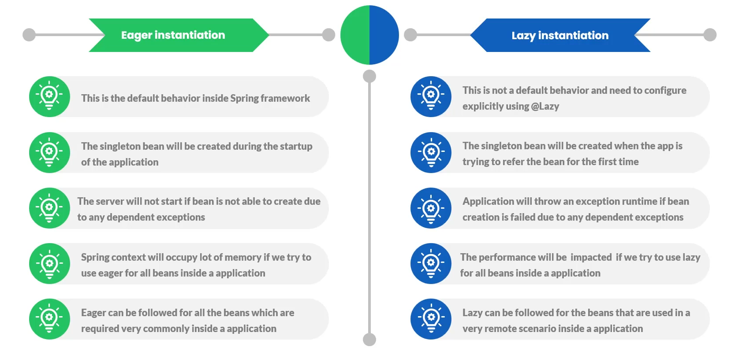
Eager and Lazy Instantiation

Slide 42
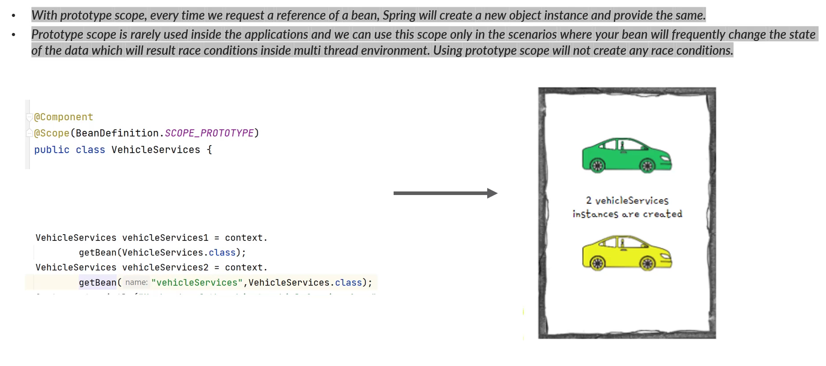
Prototype Bean Scope

Slide 43
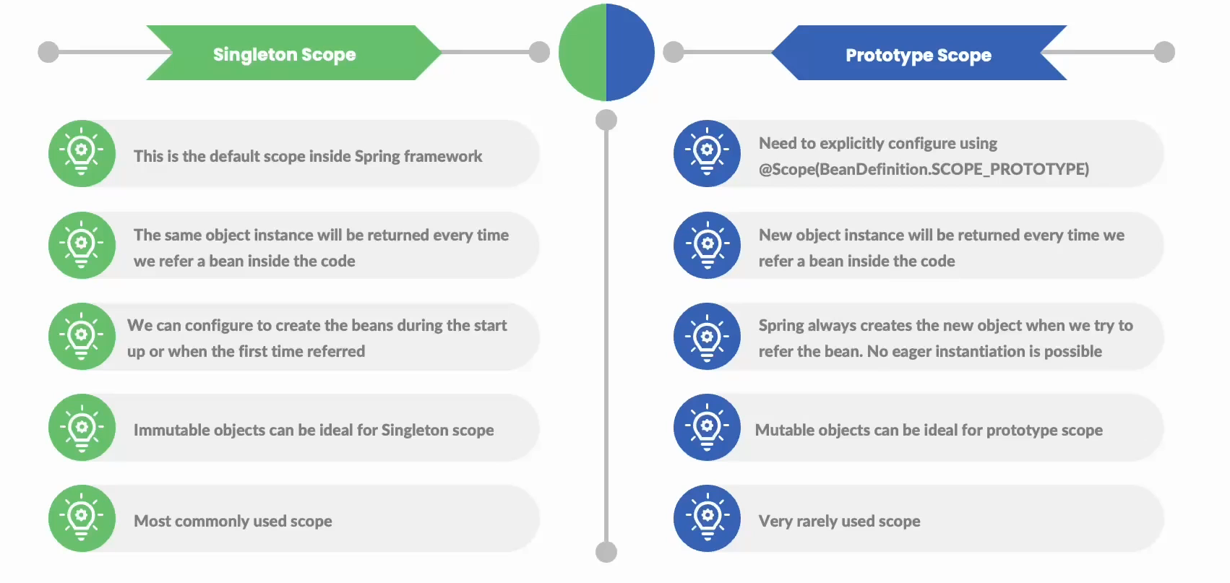
Singleton Vs. Prototype Bean

Slide 44
Assignment
Create a MessageService interface with method
public void sendMsg(String message);
Provide two implementations
EmailService
SMSService
TwitterService
Implement Dependency Injection Using All three methods

Slide 45
Assignment
Create a Employee interface with method
public void doWork();
Provide two implementations
Manager
Accountant
Implement Dependency Injection Using All three methods

Slide 46
Assignment
Create a Award interface with method
public void award();
Provide two implementations
BookerAward
NationalAward
PulitzerAward
Create a Writer interface with method
void write();
void getAward();
FictionWriter class and manage Autowiring
Implement Dependency Injection Using All three methods

Slide 47
Spring SpEL
The SpEL stands for Spring Expression Language. It is a powerful expression language which supports querying and manipulating an object graph at the bean creation time or run time. It is similar to other expression languages like JSP EL, OGNL, MVEL and JBoss EL etc with some additional features like method invocation and basic string templating functionality.
#{ expression }

Slide 48
Spring SpEL Uses
1. It can be used to inject a bean or a bean property in another bean.
2. It can be used to invoke a bean method in another bean.
3. It can be used to execute any standard mathematical, logical or relational operations.
4. It can be used to perform conditional checking with ternary operator.
5. It can be used to get the elements of a Map or a List

Slide 49
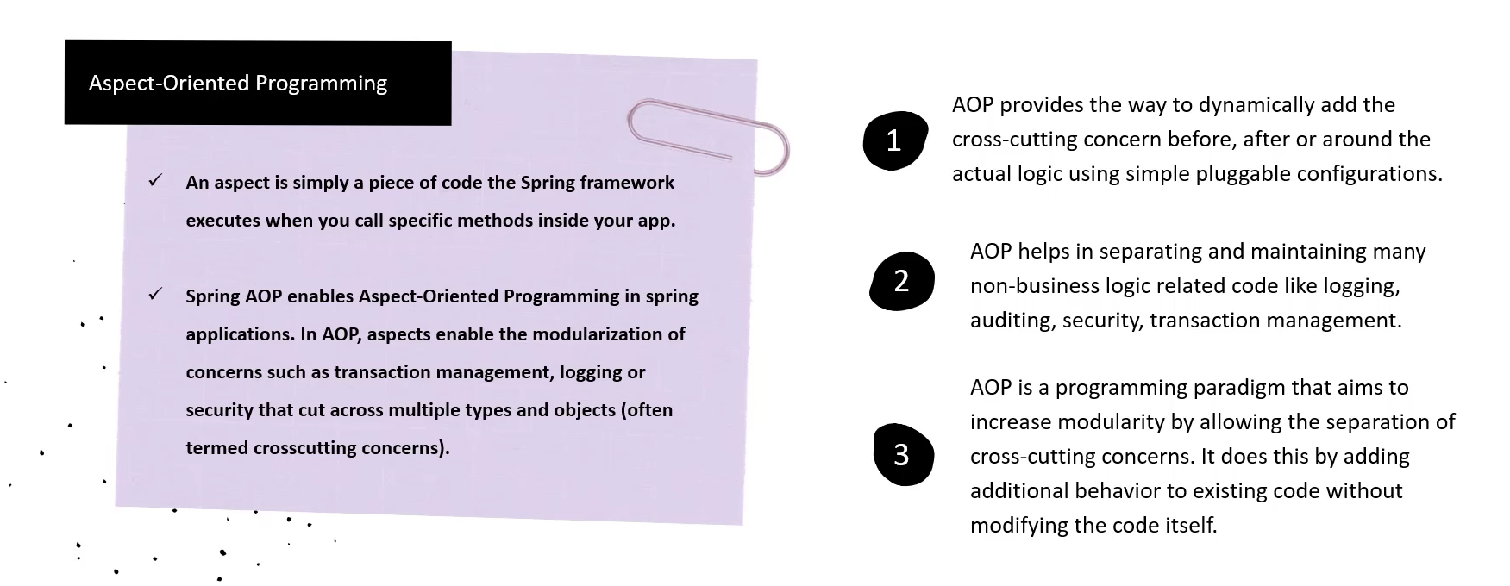
Spring Aspect Oriented Programming

Slide 50
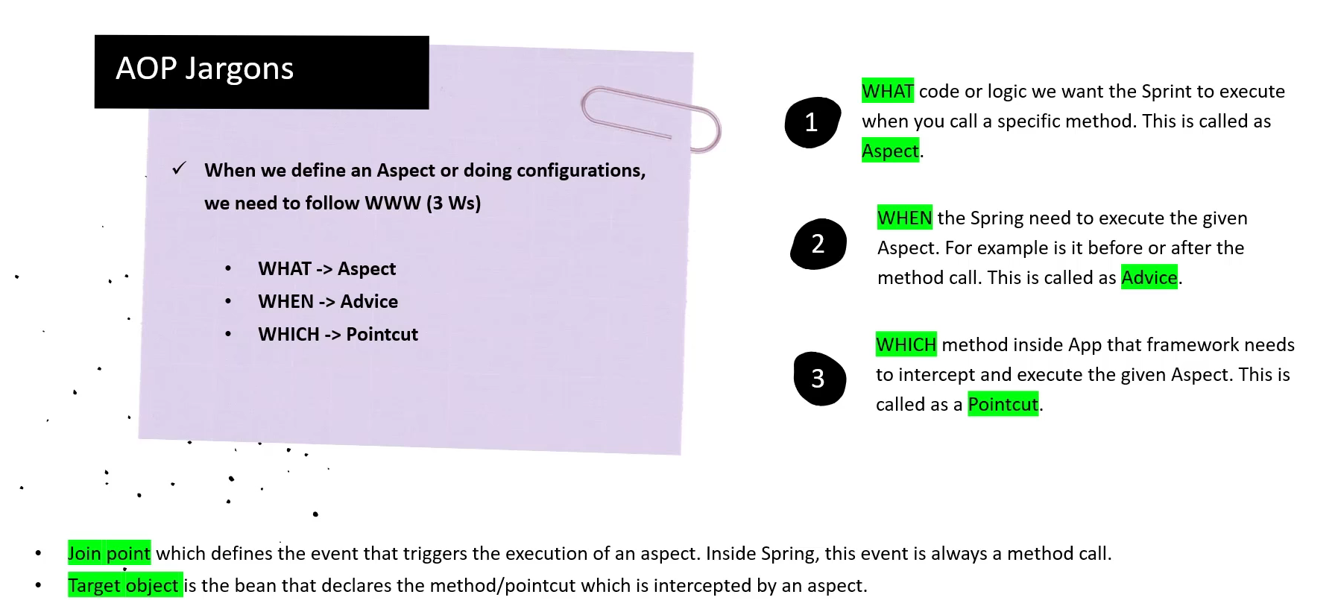

Slide 51
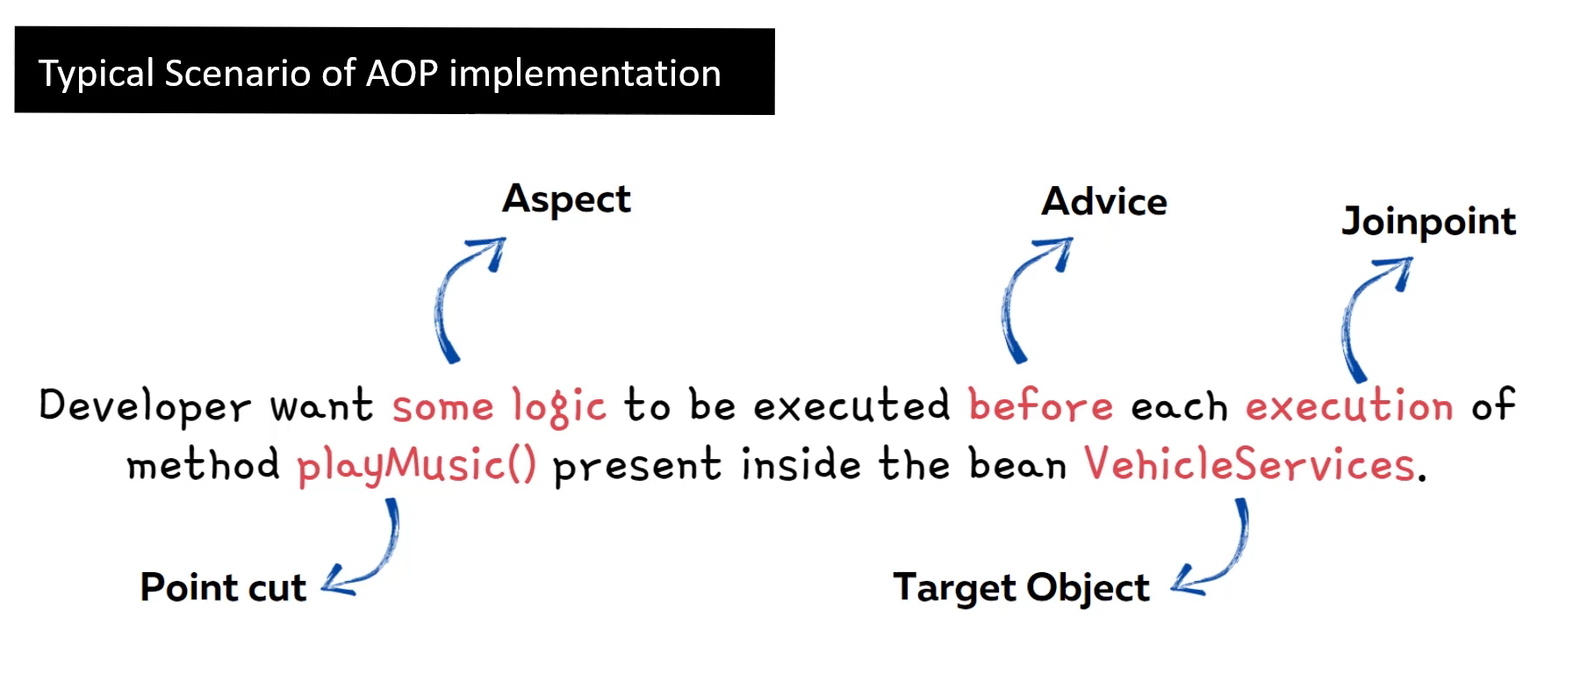

Slide 52
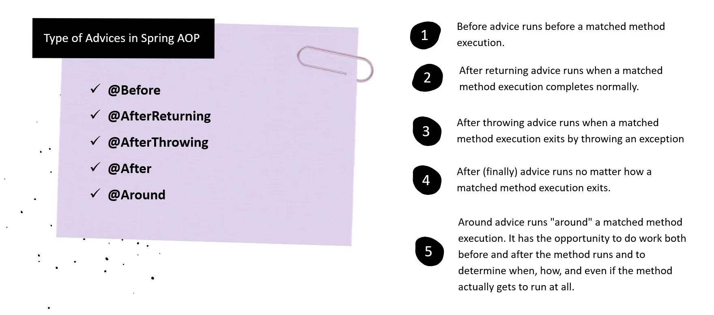

Slide 53
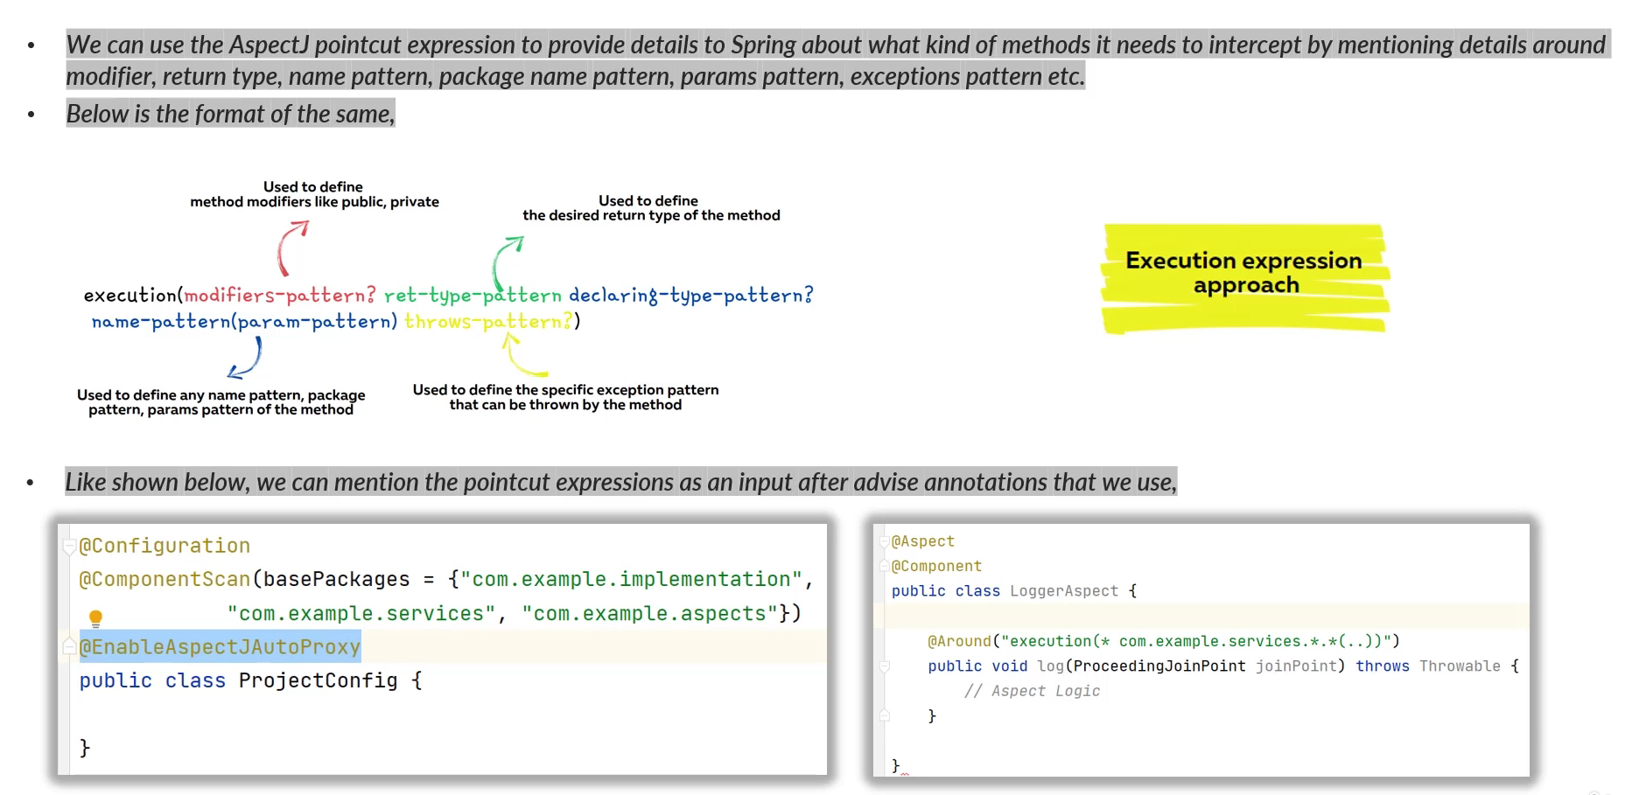

Slide 54
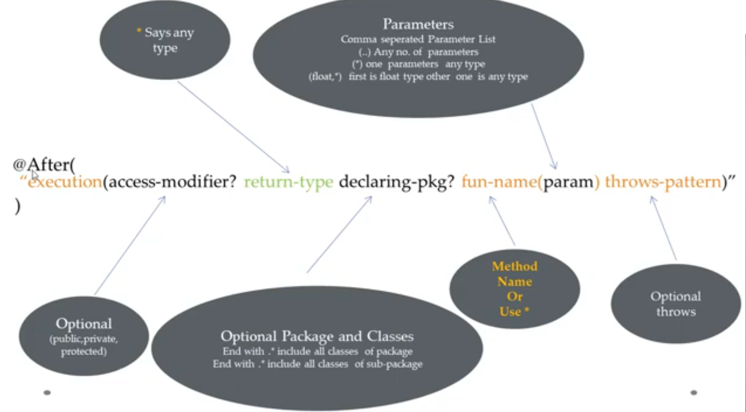

Slide 55


Slide 56


Slide 57
Spring @PropertySource Annotation
The @PropertySource is a convenient annotation for including PropertySource to Spring's Environment and allowing to inject properties via @Value into class attributes.
This annotation is used with @Configuration classes.
Spring @PropertySource annotation is repeatable, means you can have multiple @PropertySource on a Configuration class. This feature is available if you are using Java 8 or higher version.
For earlier java versions, @PropertySources was the way to provide multiple property files to the configuration class.

Slide 58
Spring @PropertySource Annotation
@PropertySource(value = "personal.properties")
@PropertySource(value = "school.properties")
@Value("${student.name}")
String name;
@Value("${student.age}")
int age;
@Value("${college.name}")
String collegename;

Slide 59
Spring @ImportResource Annotation
The @ImportResource annotation is used to load beans from an XML configuration file into an Application Context in Java configuration based applications. The class annotated with @Configuration can use @ImportResource annotation to load XML configurations.
For example, old application based on XML configuration is being upgraded to Java configuration based application, to keep bean definition at both places, in Java configuration as well as XML configuration, we can use @ImportResource annotation.
@Configuration
@ImportResource("classpath:/app-config.xml")

Slide 60


Spring @Import Annotation
The @Import annotation indicates one or more @Configuration classes to import.
For example: In a Java-based configuration, Spring provides the @Import annotation which allows for loading @Bean definitions from another configuration class.

Slide 61
Spring @Profile Annotation
Spring @Profile annotation allows developers to register beans of any configuration class by condition. For example, register beans based on what operating system (Windows, Linux, etc...) your application is running, or load a database, logging configurations based on the application running in development, test, and preproduction or production environment.
@Profile annotation has value attribute which accepts the name for the profile. We can then activate different profiles by using profile names in different environments to bootstrap just the beans we need. @Profile annotation can be used with @Configuration and @Component annotation.
@Profile with @Configuration
When we use @profile with @Configuration annotation spring will just bootstrap all the beans configured inside that configuration class. In the below example we activate the profile based on operating system so that spring just bootstrap the beans and configurations for that operating system.

Slide 62
Spring @Lookup Annotation
By default, the scope of the bean in a Spring application are singletons, and we use a constructor or setter to implement dependencies. But there is another situation: there is a singleton user, and he needs a new role bean every time. That is, User is a singleton bean, and Role is prototype bean. The life cycles of beans are different. Bean User is created by the container only once, and bean Role is created every time a new one is created – let's say this happens every time you call some method of the User bean. This is where the introduction of a bean using the @Lookup method comes in handy. It occurs not when the container is initialized, but later, each time the method is called.
A method annotated with @Lookup tells Spring to return an instance of the method's return type when we invoke it.
@Lookup
public Role createRole() {
return null;
};

Slide 63
Spring @DependsOn Annotation
The order in which Spring container creating beans cannot be predicted. When we need spring to create certain bean before creating our bean, we can choose the @DependsOn annotation for managing bean creation order. The @DependsOn annotation can force the Spring IoC container to initialize one or more beans before the bean which is annotated by @DependsOn annotation.
The @DependsOn annotation may be used on any class annotated with @Component, @Service & @Repository or on methods annotated with @Bean.
@Component
@DependsOn({"adminService", "userService"})
public class EmployeeService {
public EmployeeService() {
System.out.println("Inside EmployeeService Constuctor");
}
}
@Bean
@DependsOn({"twitterService", "emailService"})
public SMSService smsService()
{
return new SMSService();
}

